Slide 1
Generating images using GAN
By Christopher Imantaka

Slide 2
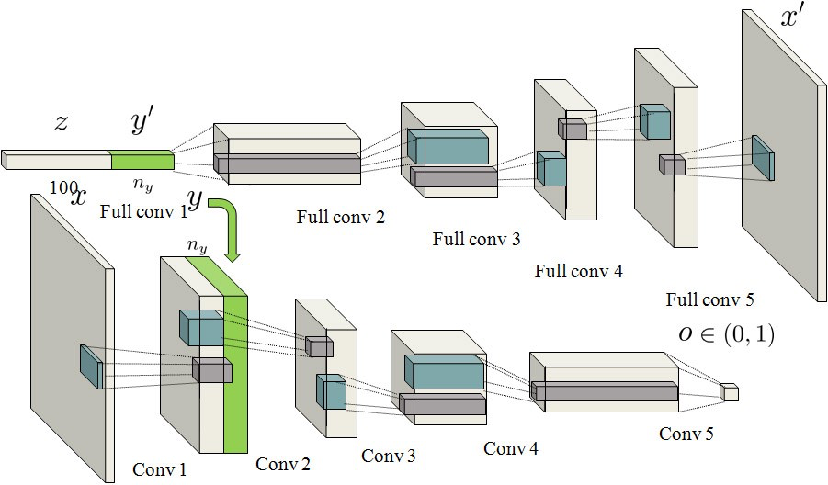
Deep Convolutional GAN
Deep Convolutional networks
Better performance with images
Conditional DCGAN
Class information added to the input
Notes:
The image is taken from
https://medium.com/@sam.maddrellmander/conditional-dcgan-in-tensorflow-336f8b03b7b6

Slide 3
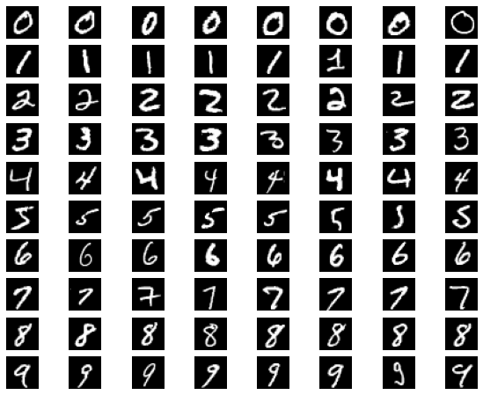
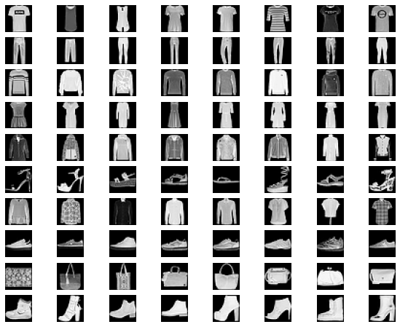
Data set

Slide 4
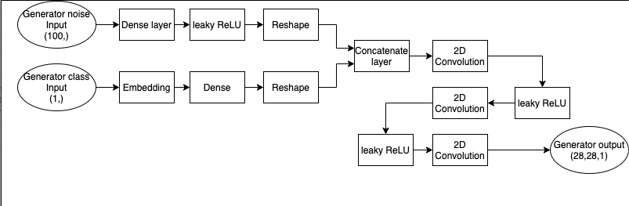
Architecture of the implemented model
Generator model

Slide 5
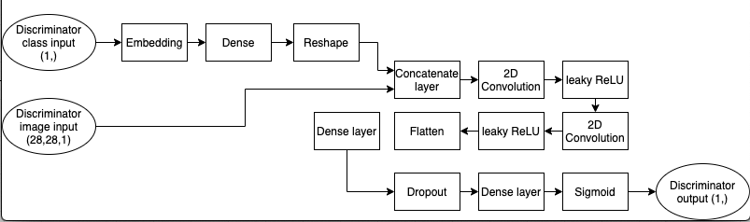
Architecture of the implemented model
Discriminator model

Slide 6
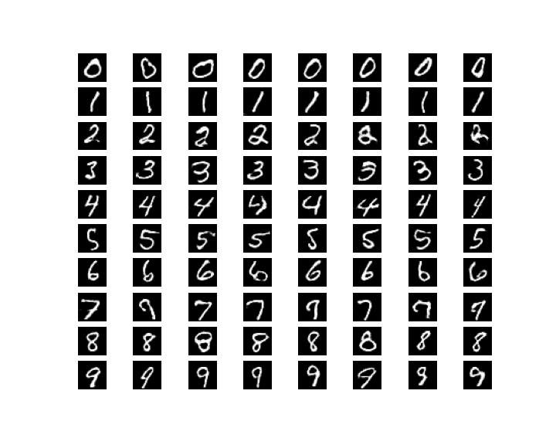
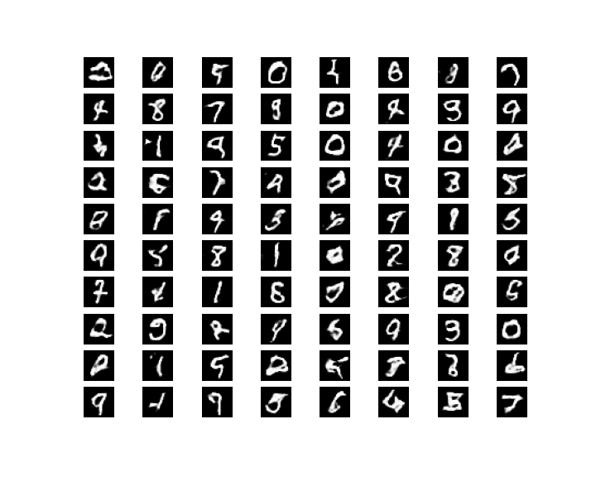
Result
Conditional DCGAN
Vanilla DCGAN

Slide 7

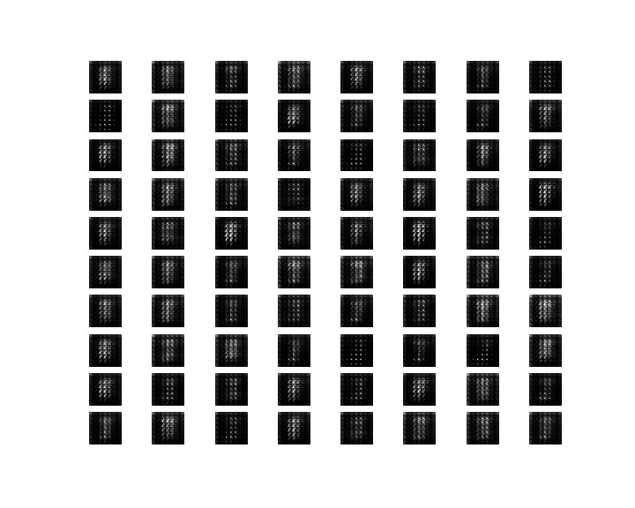
Learning Speed
Conditional DCGAN
Vanilla DCGAN

Slide 8
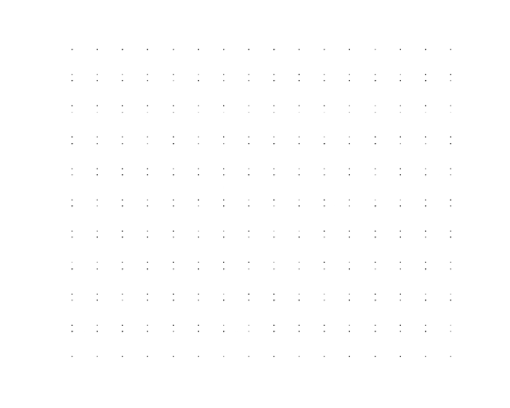
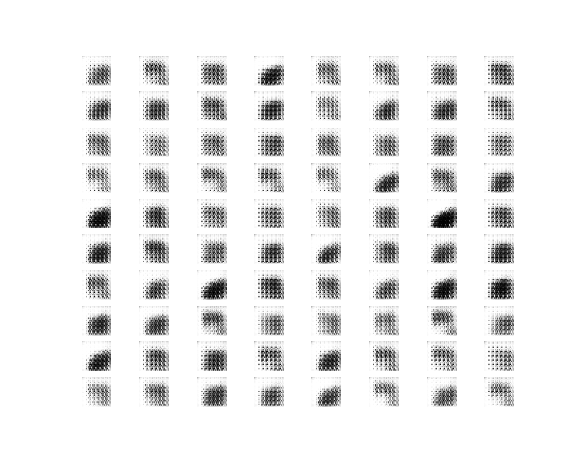
Another dataset

